Slide 1
Tech Sense Web App
MINOR PROJECT-02 (Panel – 06)

Slide 2
Project Group Members Bhavya Tyagi (181B070) Bhawana Mishra (181B071) Chandan Kumar (181B074) Project Mentor Mr. K.B. Meena

Slide 3
Introduction (Tech Sense – makes sense!)
Idea: Web app containing technical blogs with recommendations of other tech articles.
Motivation: 1. Keeps updated: Helps in being technologically sound and connected with tech world, with just one app. 2. Aid to the tech-enthusiasts: Crisp product for the technology advancement curious minds, which will save their time of searching related articles.

Slide 4
Related Works
Web Scrapping: Extraction of data is used to make content factually defined and accumulate advanced features in one’s work model.
Blogging Websites and Apps: Informative websites aimed at helping people understand and use technology in a better way, like Medium, Beebom etc..
Social Media Sites: Various types of Recommendation System: Popularity based, Content based and Collaborative filtering have heavy application in social media sites, general data sites or in enhancing content.

Slide 5
Feasibility Study
It is feasible in scheduling considerations, technical and legal foregrounds.
Underlying Concept: Amalgamation of Web App Development and Machine Learning
The model requires: 1. JavaScript Development (for both frontend and backend; respective frameworks: React and Nodejs) 2. Google Login 3. Methods from ML (to web scrap tech sites for recommendation system)

Slide 6
Feasibility Study
A small and authentic data source related to technology science for web scrapping will be used.
Dependency: The project is dependent on the sites we use for web scrapping for our articles.
Limitation: The recommendation system will depend on the data, so, it can so far restrict the content.

Slide 7
Requirement Analysis
Software Requirements: HTML5, CSS3, React(v 17.0.1) – NodeJs(v 13.12.0) (JavaScript development), Python3, Adobe tools(v cc2019),VS Code(v 1.53.2), Jupyter Notebook(v 6.1.1)
Hardware Requirements: 1. CPU: 1.60 GHz processor and above 2. Disk Storage: 8GB of free disk space
For UI Development: Adobe XD, AI, PS, AE
For Recommendation system: Web Scrapping using BeautifulSoup4(v. 4.9) and Newspaper(v 0.2.8)

Slide 8
Important Visualization
Prepare Animation & Logo
Prepare UI Layout
Developing Frontend
Generating Recommendation System
Developing Backend & Firebase
Evaluating the project
Figure-1: Block Chart

Slide 9

Designs
Figure-2: Logo

Slide 10
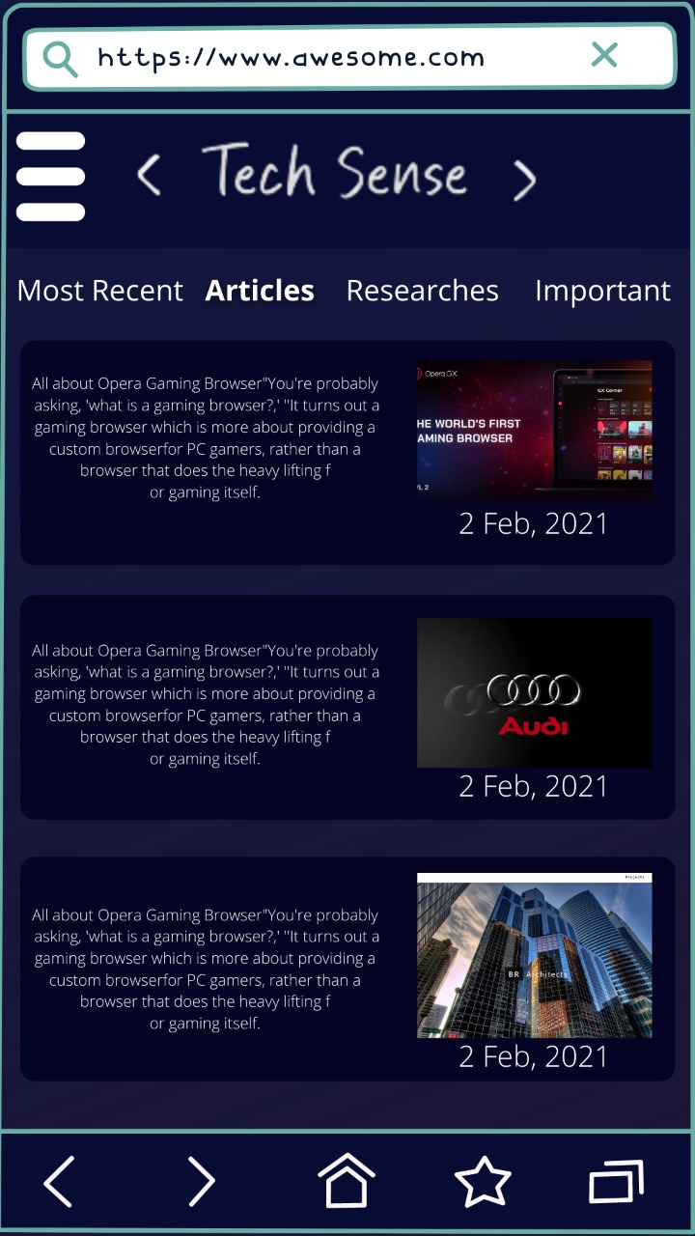
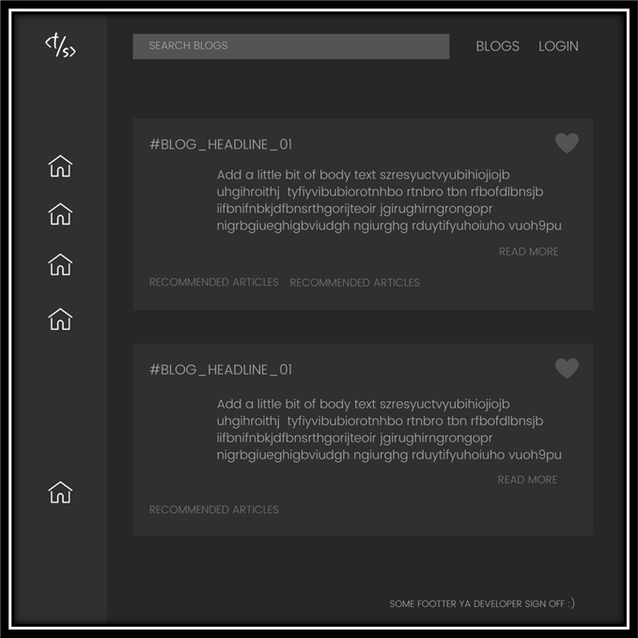
Designs
Figure-3: UI Design Template

Slide 11
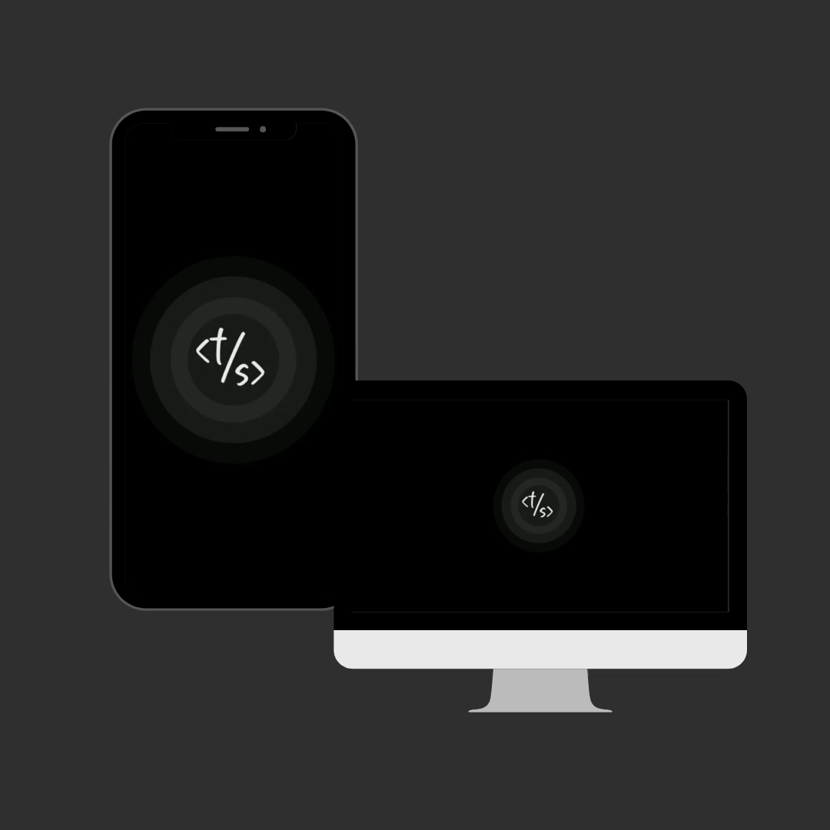
Designs
Figure-4: Loading Page Animation

Slide 12
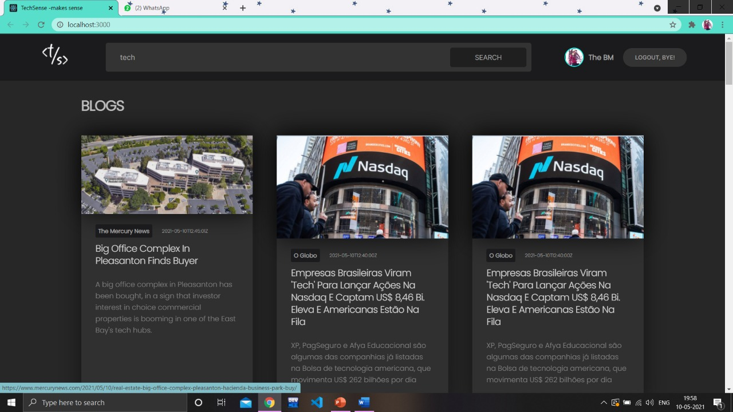
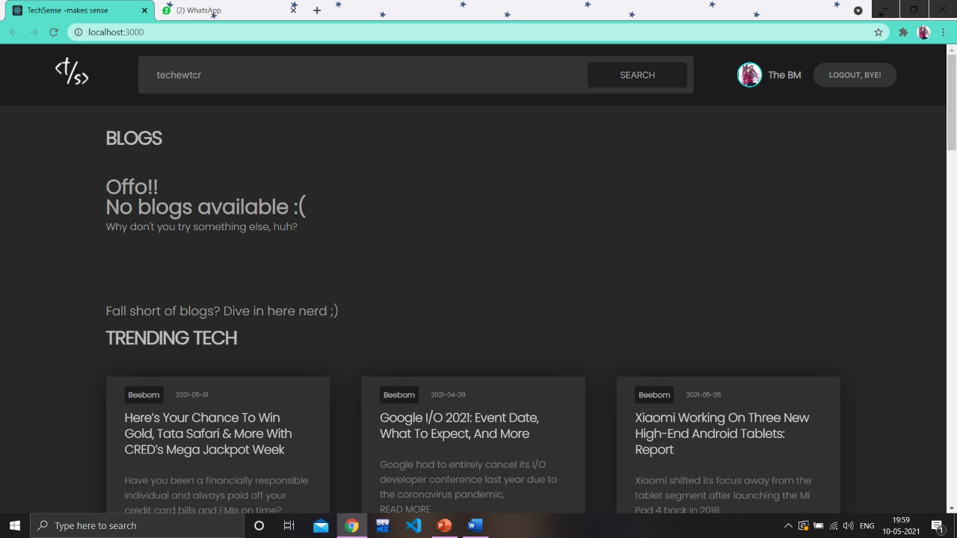
Screenshots
Figure-5: Implementation Results

Slide 13
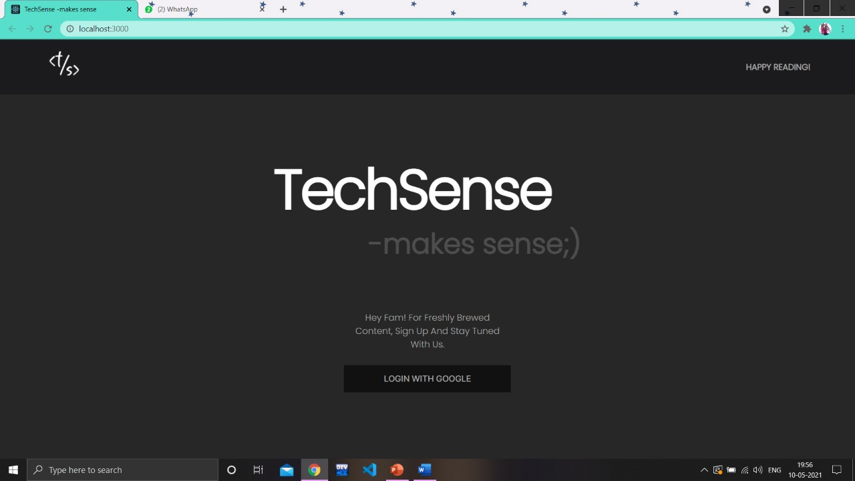
Screenshots
Figure-6: Home Page

Slide 14
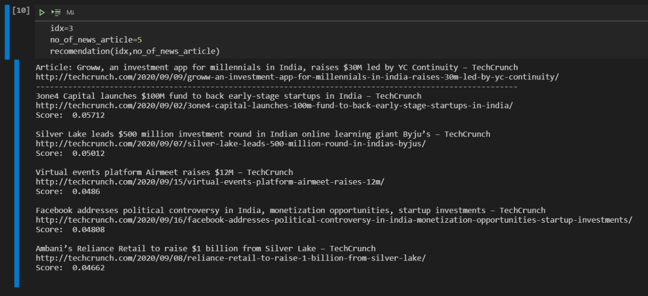
Screenshots
Figure-8: Code snippet of ‘recommending articles’

Slide 15
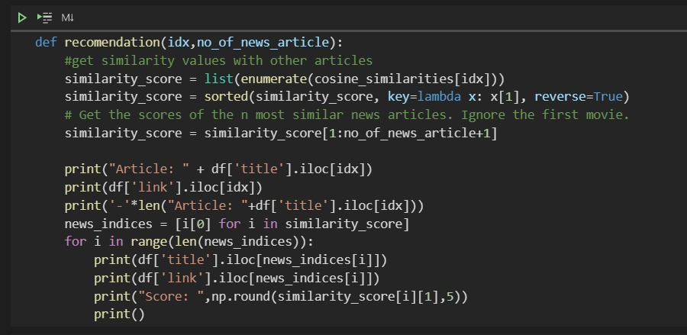
Screenshots
Figure-9: Code snippet of function

Slide 16
Conclusion
Goal: Technical web app with recommendation system
Domains: 1. Web-development: JS Development with Google Login and Api 2. Recommendation system: ML-Web Scrapping
UI-UX: Web App with Dark UI
Modification Idea: 1. Increasing site sources 2. Adding ‘Like’ and ‘Save’ feature

Slide 17
References
https://en.wikipedia.org/
https://beebom.com/
https://www.w3schools.com/
https://www.youtube.com/
https://arxiv.org/ftp/arxiv/papers/1707/1707.00506.pdf
https://blog.insightdatascience.com/news4u-recommend-stories-based-on-collaborative-reader-behavior-9b049b6724c4

Slide 18
Thank You! :)

